Slide 1
Level 6 Group 3
River Chick
Michael Curtis
Ryan Manthorp
Ogheneochuko Ideh

Slide 2
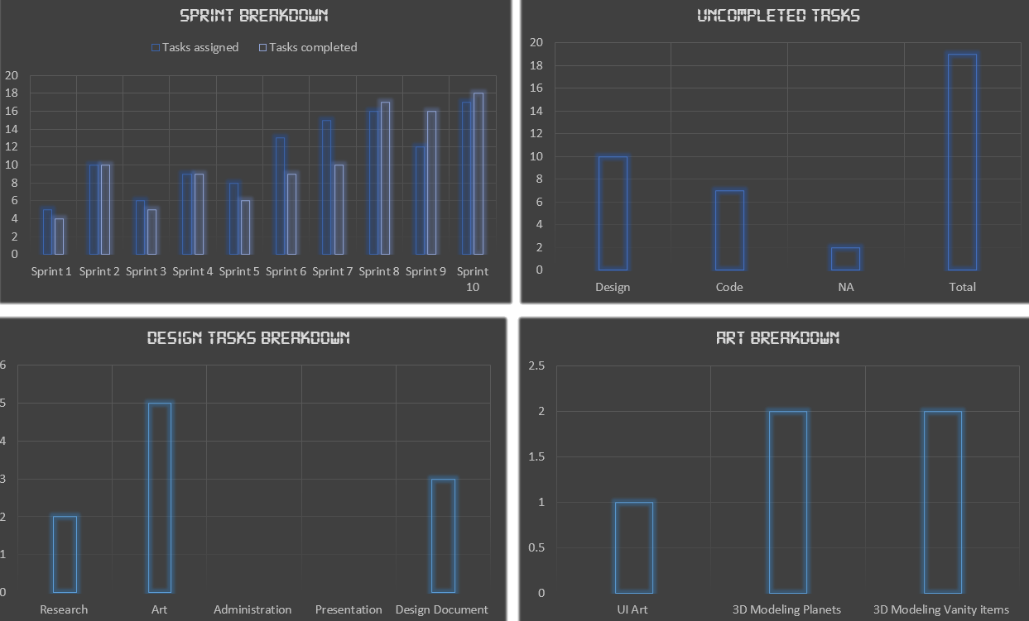
Management: Isolating project blockers

Slide 3
Playtesting

Slide 4
Usability Testing
‘Likes the artstyle’
‘In-game store is not intuitive enough’
‘UI values look like button’

Slide 5
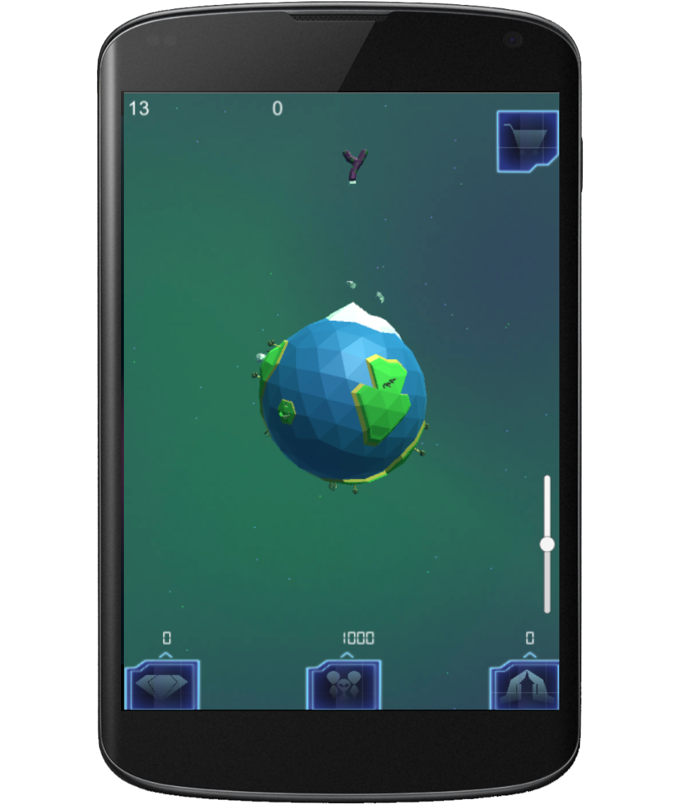
Ui Usability Testing

Slide 6
Strengths
Opportunity for endless gameplay.
Targeted at a bountiful demographic.
Lots of investment opportunities.
Opportunity for strategic gameplay.

Slide 7
Weaknesses
Slow paced gameplay.
Information overload.
Hard to learn.

Slide 8
Key Tasks going forward
Asteriod chain mechanic to be implemented.
Overhaul UI for store.
Complete planet models.
Introduction moon composition and perk system.

